Slide 1

Why thinking about individual movement is important for species-habitat modelling
Montpellier December 2017
Jason Matthiopoulos
University of Glasgow

Slide 2
Some short questions with, potentially, very long answers
What is the spatial scale at which individuals respond to their environment?
How can we anticipate different species responses to changing environments?
How can we relate spatial observations to the niche of a species?
What is the formal relationship between individual movement and population redistribution?
Can we speed up statistical inference in movement ecology to deal with increasing data sets?
How can we achieve a better sample size by combining transect and telemetry data?
Notes:
A very broad and superficially unconnected set of questions, all with a loosely spatial/habitat/movement association. But there is a common thread.

Slide 3
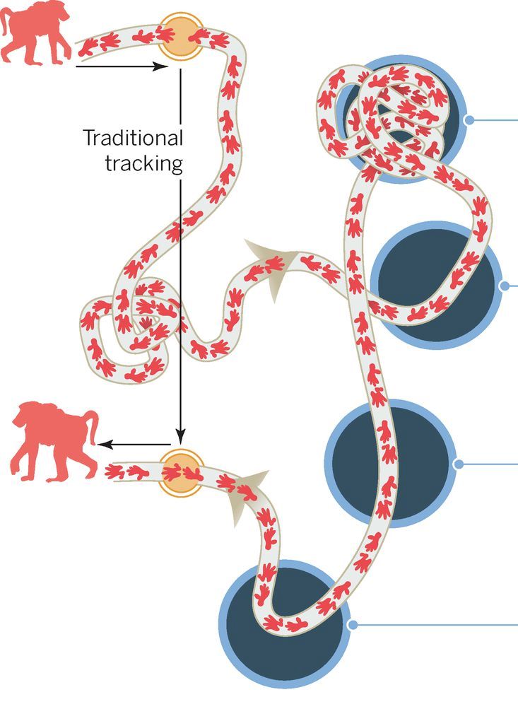
A tidier taxonomy of questions
How does habitat shape:
Individual behaviour
How can we anticipate different species responses to changing environments?
How can we relate spatial observations to the niche of a species?
What is the formal relationship between individual movement and population redistribution?
Can we speed up statistical inference in movement ecology to deal with increasing data sets?
How can I achieve a better sample size by combining transect and telemetry data?
Notes:
Will deal with a triptych of questions. Big data (e.g. telemetry) can most readily be processed to answer these three questions, but only if we pay attention at aspects of movement. Even though, SDMs

Slide 4
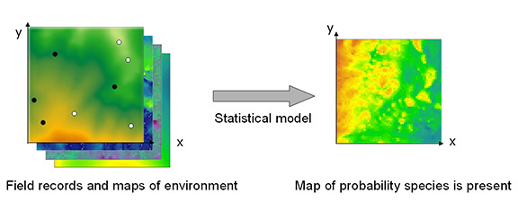
A tidier taxonomy of questions
How does habitat shape:
Individual behaviour
Space use
How can we relate spatial observations to the niche of a species?
Can we speed up statistical inference in movement ecology to deal with increasing data sets?
How can I achieve a better sample size by combining transect and telemetry data?
Notes:
Will deal with a triptych of questions. Big data (e.g. telemetry) can most readily be processed to answer these three questions, but only if we pay attention at aspects of movement. Even though, SDMs

Slide 5
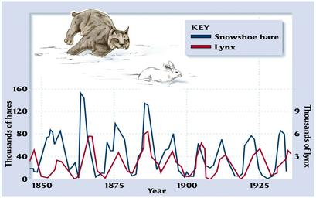
A tidier taxonomy of questions
How does habitat shape:
Individual behaviour
Space use
Population dynamics
Can we speed up statistical inference in movement ecology to deal with increasing data sets?
How can I achieve a better sample size by combining transect and telemetry data?
Notes:
Will deal with a triptych of questions. Big data (e.g. telemetry) can most readily be processed to answer these three questions, but only if we pay attention at aspects of movement. Even though, SDMs

Slide 6
A tidier taxonomy of questions
How does habitat shape:
Individual behaviour
Space use
Population dynamics
How do we capture and quantify these effects with biologically realistic statistical models?
Notes:
Will deal with a triptych of questions. Big data (e.g. telemetry) can most readily be processed to answer these three questions, but only if we pay attention at aspects of movement. Even though, SDMs

Slide 7
The thesis of this talk
All of these questions can be answered via approaches that are rooted in species-habitat association models
None of these questions can be answered without explicitly thinking about movement.
Notes:
In this talk I will argue that this very comprehensive set of questions and be answered by approaches based on species-habitat modelling, but that none of these questions can be tackled satisfactorily without explicitly thinking about individual movement.

Slide 8

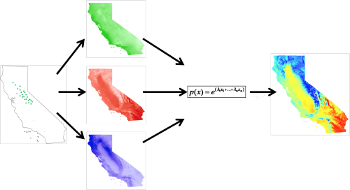
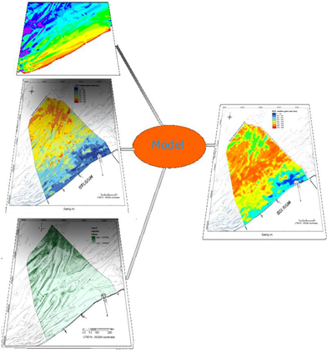
Statistical Species-Habitat models
Arguably, the fastest method of analysing large data sets of space use observations (including movement data).
Notes:
Typical picture when thinking about SHMs. But the devil is in the detail. In particular, the challenges first become apparent when one considers the issue of availability (a problem ignored by effort-free analysis approaches).

Slide 9
“Niche”-related models
Environmental variable 2
Environmental variable 1
E.g. the use of multivariate ordination methods, such as Principal Components Analysis.
Notes:
Consider the widespread class of “niche-related” models which consider solely the occurrence of a species in environmental space. Niche-related models fit different mathematical structures to the cloud of occurrence points. By doing that, in the above simple example, we may be tempted to conclude that the orientation of habitat preference is BL to TR. However, this plot does not show us the full set of habitats from which this organism is choosing. The two “outliers” to the top left are excluded from the bulk of the preference. These models claim to be able to quantify the niche of a species, on the basis that if a species is present at some location, clearly it is able to survive there. Of course, this is not true. Species can be absent from suitable habitat, or they can be present in (sink) habitat in which they cannot survive in the long-term

Slide 10



“Niche”-related models
So-called ‘niche’ models “estimate niche-related objects at an unknown point along a continuum between the fundamental and occupied niche”.
Townsend Peterson
Jorge Soberon

Slide 11
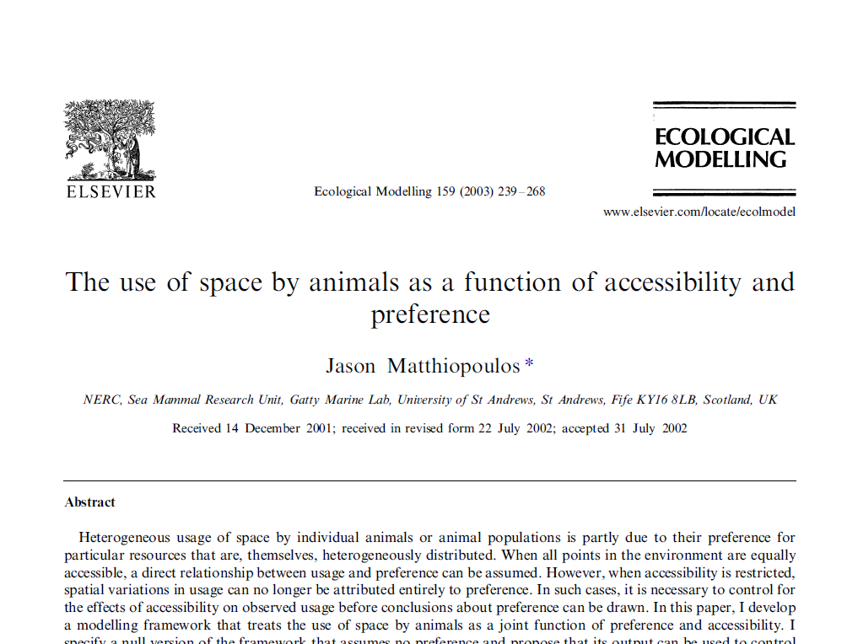
“Niche”-related models
Environmental variable 2
Environmental variable 1
Notes:
If we were to add the information on availability, we may be able to notice slightly different patterns in habitat preference. For example, the extreme regions to the left and right are clearly avoided, because they are highly available but sparsely used. In contrast, what were previously considered outlying points now become highly influential for our inferences on preference, because they indicate habitats that are highly used compared to their low availability

Slide 12
The spectre of availability
Environmental variable 2
Environmental variable 1

Slide 13
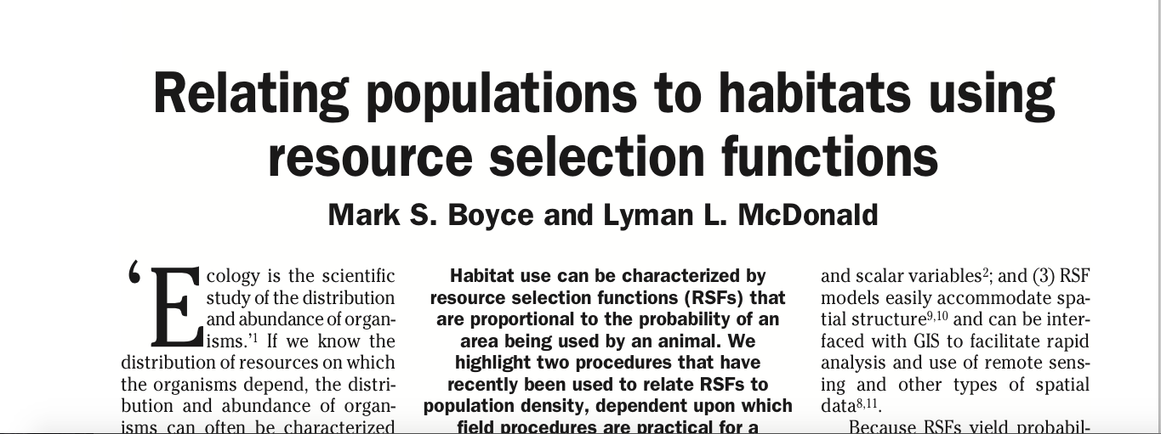
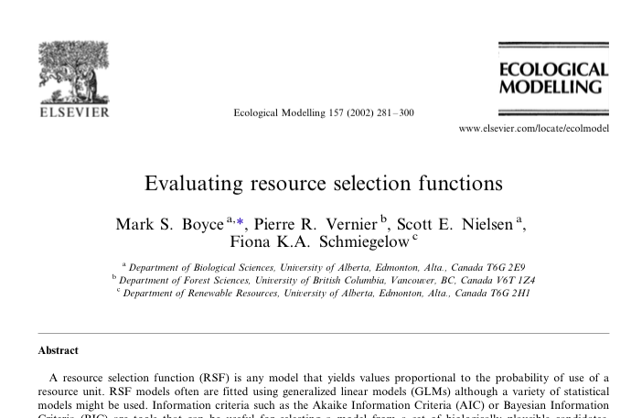
Habitat preference
Notes:
SDMs are implicitly or explicitly motivated by a concept of habitat preference, which in the more defensible SDMs and in its simplest form is expressed as a ratio of the amount of habitat usage over habitat availability. This is usually modeled as the exponential of a linear predictor of covariates (irrespective of the type of movement and usage data available). Discussion of how best to deal with count, presence-only and occupancy data on usage is interesting (and worthy of a different talk) but almost settled in the literature (point out Aarts paper). But today, I will be mostly focusing on the denominator of this expression, availability.

Slide 14
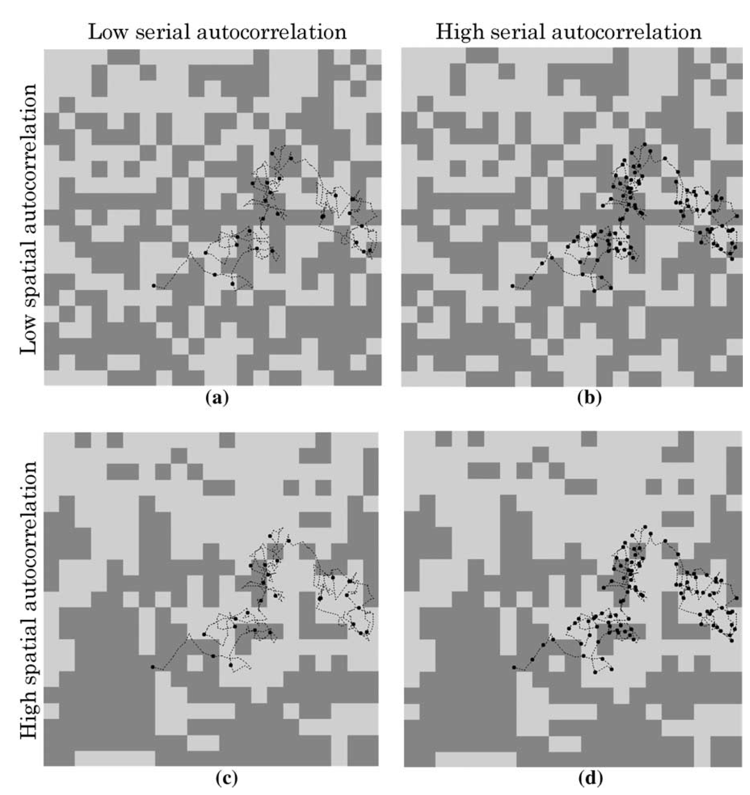
The main challenge: What is habitat availability?
Availability is determined by accessibility (movement!)
Notes:
Habitat availability, i.e. the options that the individual is presented with, critically depend on accessibility of different habitats. And this is where movement creeps into all models of habitat preference. The process can be outlined succinctly, in terms of the interplay between spatial and temporal autocorrelation. Consider a broader landscape comprising just two habitats whose overall availability is the same in all plots. Explain plot in terms of availability in a setting of a given animal speed (high on the left, low on the right). In the “best” case scenario(top left) of a rapidly moving individual existing in a highly heterogeneous habitat, it is very easy for the animal to experience everything that the landscape has to offer. However, a slow-moving animal in a strongly autocorrelated landscape, cannot easily escape its current conditions and is therefore experiencing a constrained availability.

Slide 15
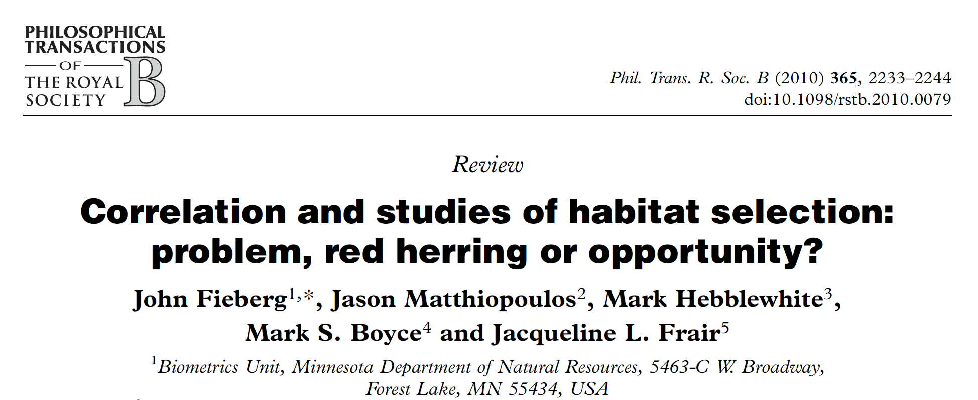
The easy way out…
…is to treat limitations in accessibility as a nuisance.
E.g., the entire literature on “treating” autocorrelation.
Alternatively, this can be faced as an opportunity to learn and increase the predictive power of our models.

Slide 16
A tidier taxonomy of questions
How does habitat shape:
Individual behaviour
Space use
Population dynamics
How do we capture and quantify these effects with biologically realistic statistical models?
Notes:
Going back to our main questions, it is easier to start from the one in the middle, simply because it is relatively more obvious that SHMs can be used to answer questions on the spatial distributions of a species.

Slide 17
How is spatial utilisation shaped by habitat?

Slide 18
G- and E-spaces
+
=
G-plots of environmental variables
Habitat type and its availability in E-space

Slide 19
Functional Responses in Habitat Preference

Slide 20
Functional Responses in Habitat Preference

Slide 21
Functional Responses in Habitat Preference

Slide 22
Functional Responses in Habitat Preference
Species-habitat models are generally
Not transferrable

Slide 23
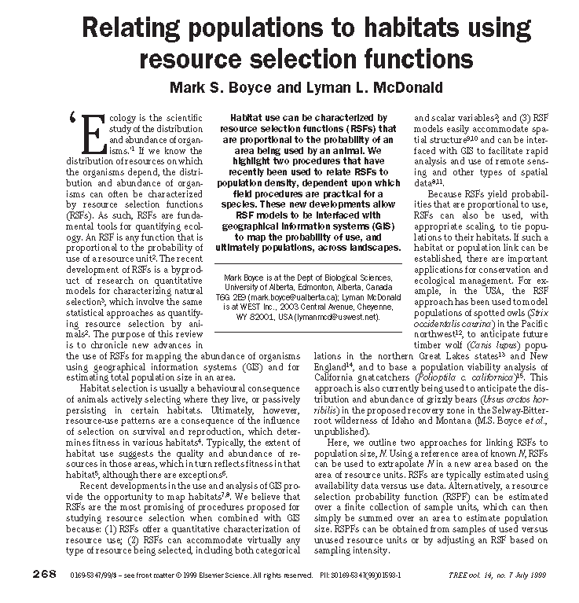
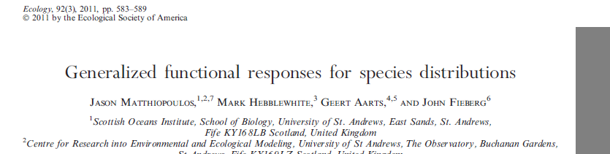
How can we predict space use in new places and times?
Measure the response of the species at multiple sampling instances, covering diverse scenarios of habitat availability.
Construct a “model-of-models” whose regressions coefficients are functions of habitat availability.

Slide 24
Generalised Functional Responses

Slide 25
Can we learn how the organisms’ use of space changes by simultaneously fitting to several different environmental scenarios?
Resource Selection Function
RSF with Generalised Functional Response

Slide 26
Generalised functional response
Pairwise interaction terms between all covariates and all expectations
Random intercept
Fixed effect of expectations
Random coefficients in response to covariates

Slide 27
In English?
The local response of an organism to its environment can be described in terms of the environment’s makeup…
… via simple statistics such as the means and variances of the marginal distributions of the availability PDF.

Slide 28
Implementation in R
mod0: Use ~ Food + Cover
mod1: Use ~ Food + Cover +
EC1 + EF1 +
Food:EF1 + Food:EC1 + Cover:EF1 + Cover:EC1

Slide 29
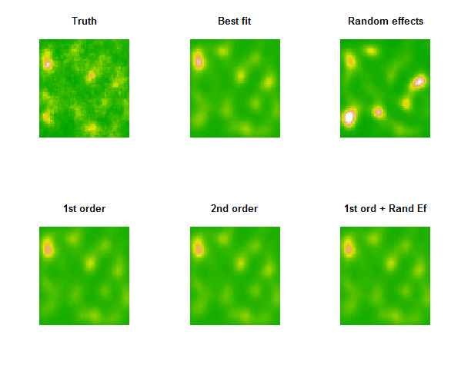
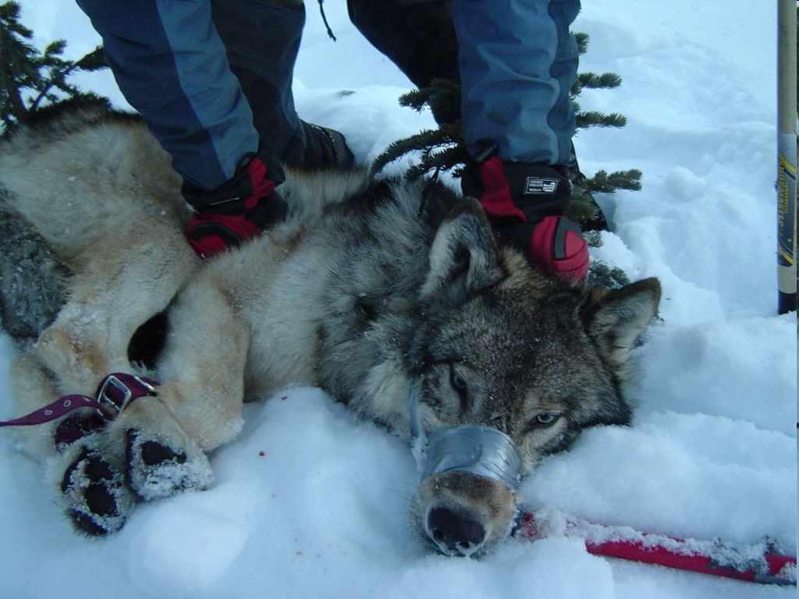
Transferrable predictions
Unobserved truth
Resource Selection Function
Generalised Functional Response

Slide 30
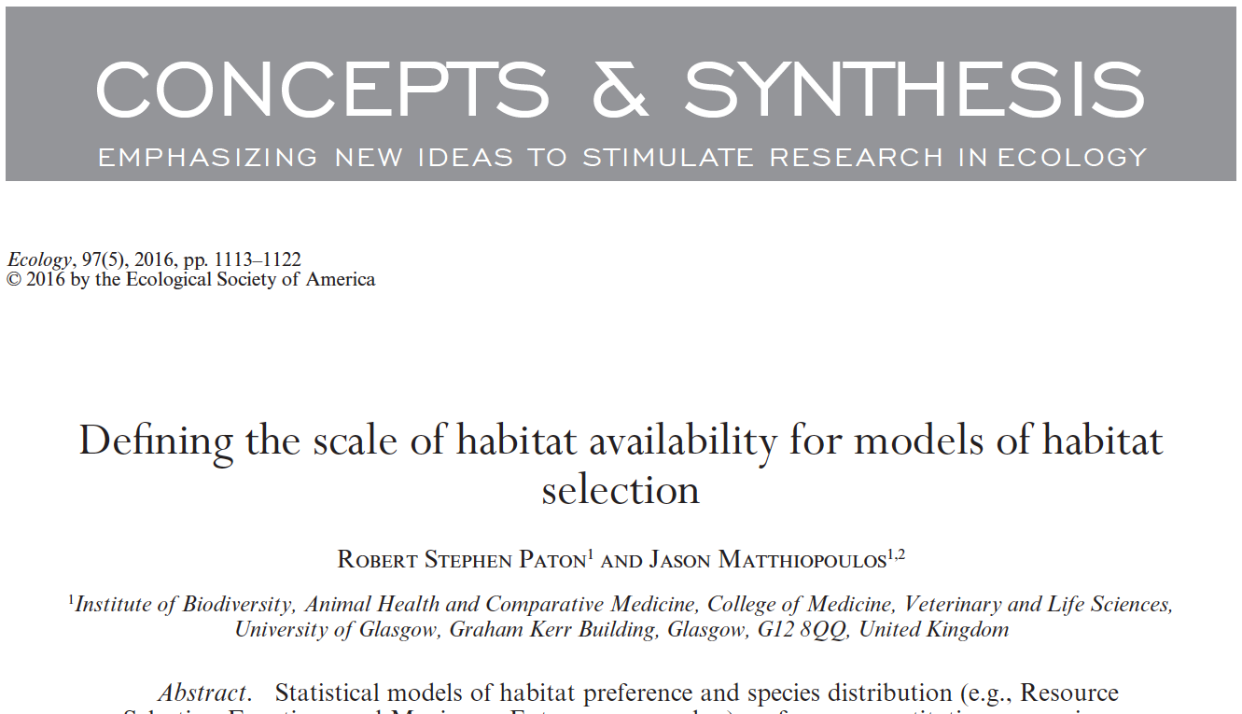
The problem: What is the appropriate scale of a sampling instance?
A fundamental trade-off between scales:
Large scales Small scales
Homogenisation Non-transferability
Notes:
GFRs require a definition of habitat availability. For home ranging animals, like the wolves of the previous example, this is relatively straightforward to define. But, given a snapshot of distributional data from ranging animals, this is not so clear. This is not just an academic problem. If the scale of availability is set too high, the model glosses over fine features of usage at small scales, and its predictions are homogenised. I.e. they fail to capture hot and cold spots in distribution. On the other hand, if scale is set too small, the model fails to learn how the surrounding environment influences the decisions of animals locally, and its predictions are once again poorly transferrable. Considerations of movement can be very useful here. If we use a heuristic criterion (e.g. the AIC) to select the best scale we find that application of the GFR on a cell-by-cell basis gives considerable protection against falling foul of the extremes of this trade-off.

Slide 31
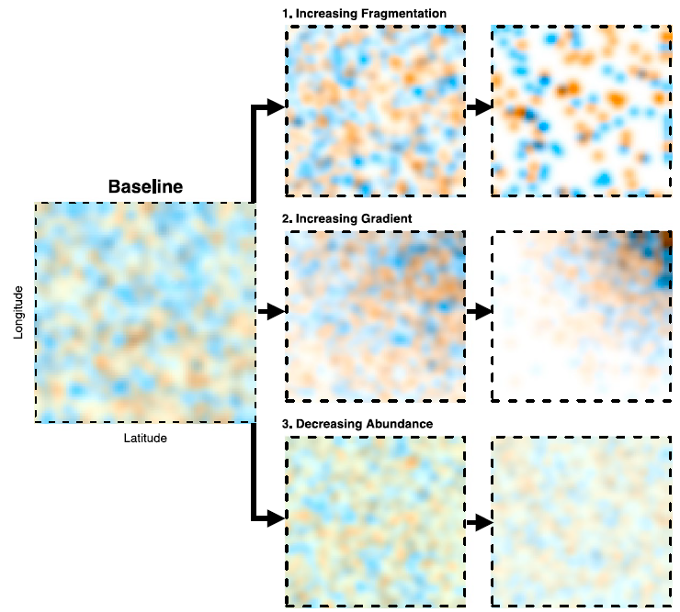
The solution: A point-by-point GFR
A fundamental trade-off between scales:
What are the attributes of mobility and behaviour that give rise to the characteristic scale that best describes the observations?

Slide 32
How is individual movement shaped by habitat?
Credit: Kays, Crofoot, Jetz, Wikelski (2015)

Slide 33
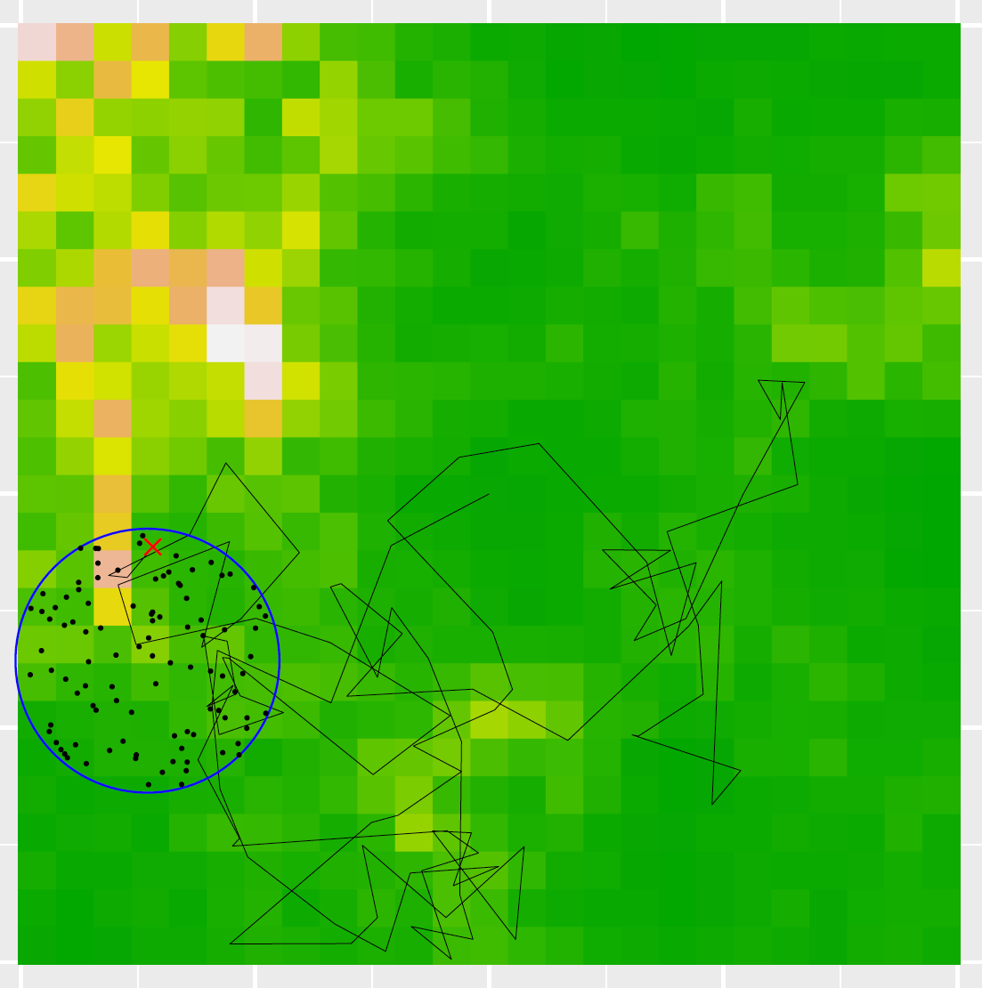
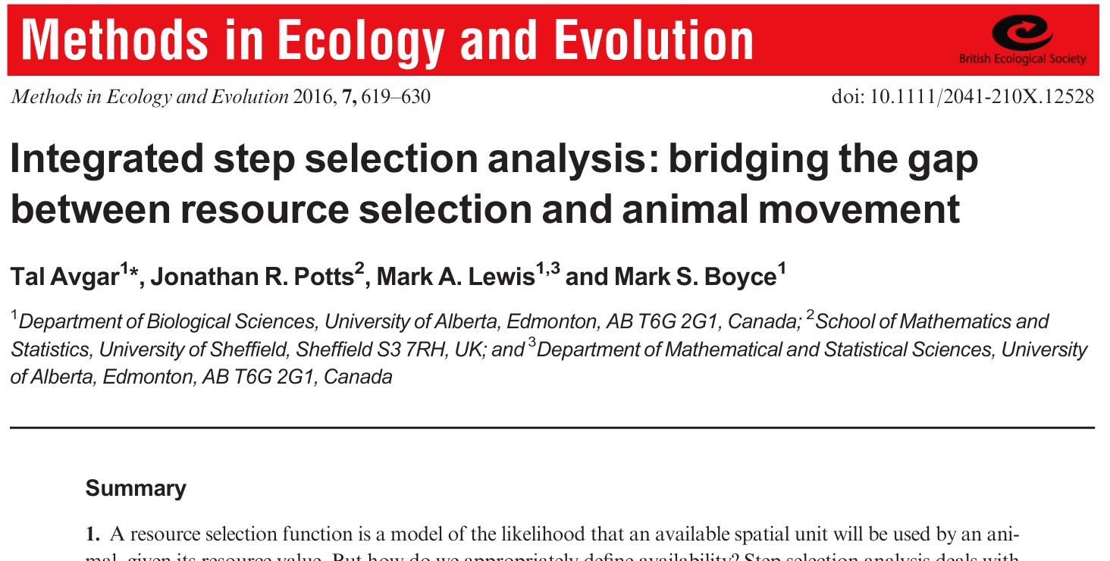
The method: Step Selection Functions
Habitat availability for the next step is defined via a model of accessibility located at the animal’s current position.
Increasingly realistic models of movement (and cognition) now being used for definition of availability.
Partly aiming at more realistic population projections?
Notes:
The way to think about individual movement (and big telemetry data) within the context of species-habitat models is the Step selection approach. This tries to limit availability to the habitat options that are truly available to the animal given its current position and mobility constraints. This research area has, in the past, laboured under the impression that the more realistically we model movement under the step selection model, the more accurate its predictions will be at the population level.

Slide 34
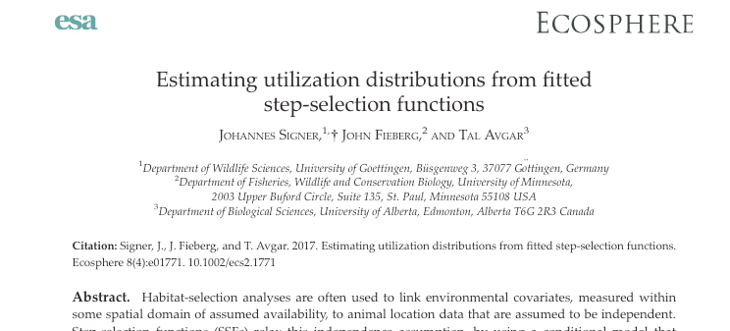
The problem: SSFs do not scale up to RSFs
A correctly formulated framework of movement must work across scales, such that, when the microscopic rules of individual movement are scaled up in space and time, they give rise to the macroscopic distribution of a population.
However, there is now both analytical and numerical evidence that the
steady-state distribution generated from SSFs does not match the spatial predictions of the RSF fitted to the same data.

Slide 35
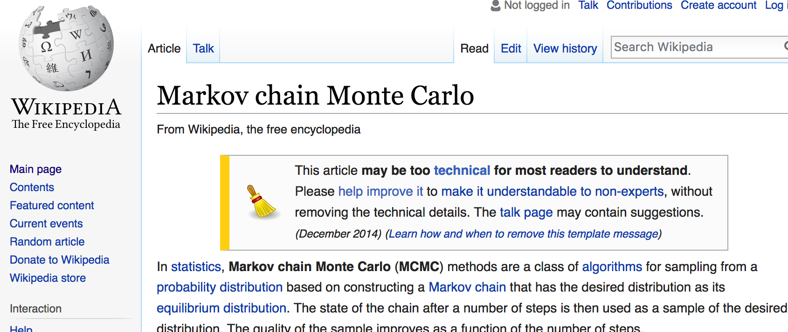
The solution: MCMC as a model of movement
Step 1 towards a solution: Acknowledge that the habitat preference function estimated at individual level (Step Selection) is not the same as the population level function (Resource Selection).
Step 2 towards a solution: Use an algorithm for step selection that scales appropriately.

Slide 36


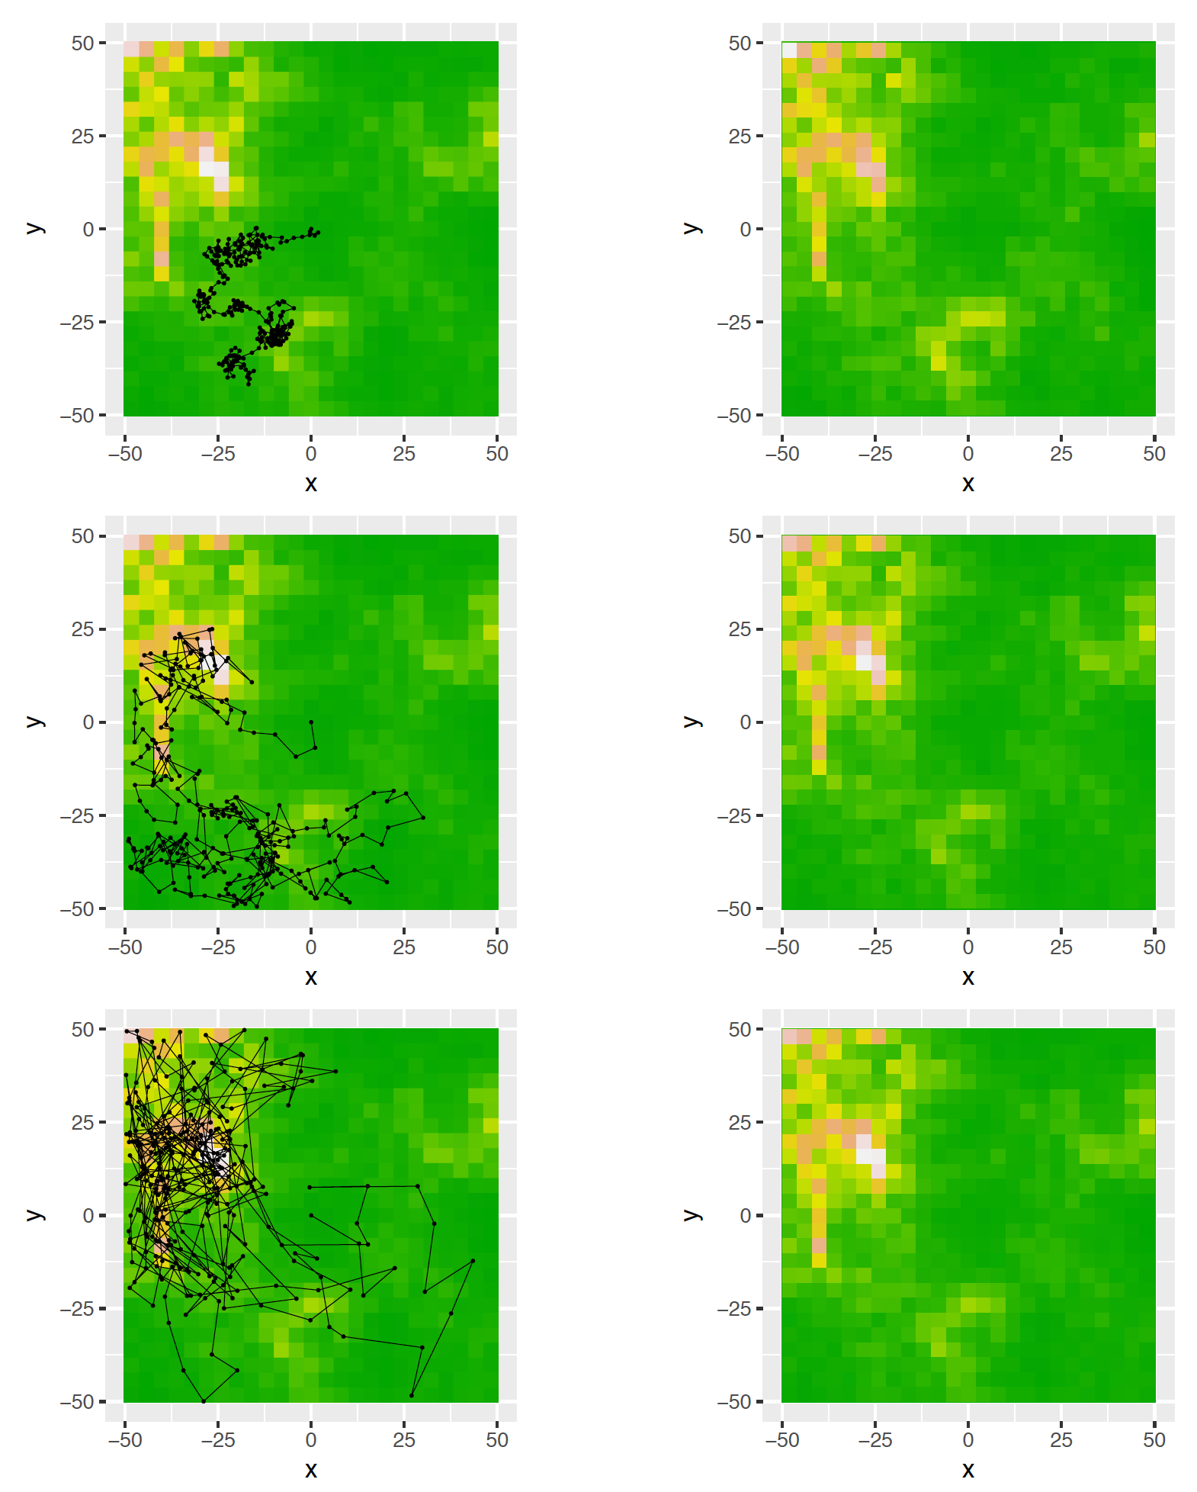
The solution: MCMC as a model of movement
Advantages:
Resolves the disagreement between RSF & SSFs
Can use very broad range of realistic movement models
Could estimate movement parameters while controlling for effect of environment (unlike current state-space approaches)
Could tell us what aspects of individual movement matter for population distribution
May allow joint inference for transect and telemetry data
Michelot, T., Blackwell, P. & Matthiopoulos, J. (In prep.) Linking resource selection and step selection models for habitat preferences in animals.

Slide 37
How are population dynamics shaped by habitat?

Slide 38
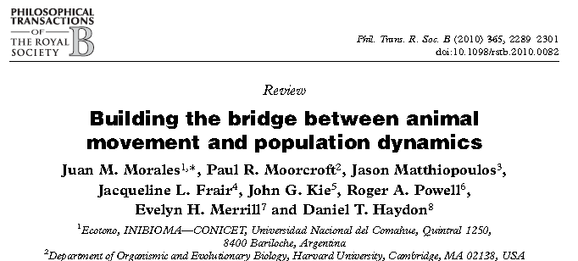
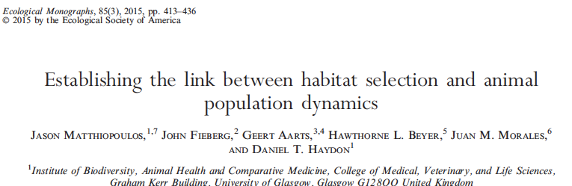
The method
Habitat preferences
Fitness
Population dynamics
Habitat availability
Spatial distribution

Slide 39


The method: Meanfield and spatial predictions of r and K
Population growth rate
Carrying capacity

Slide 40
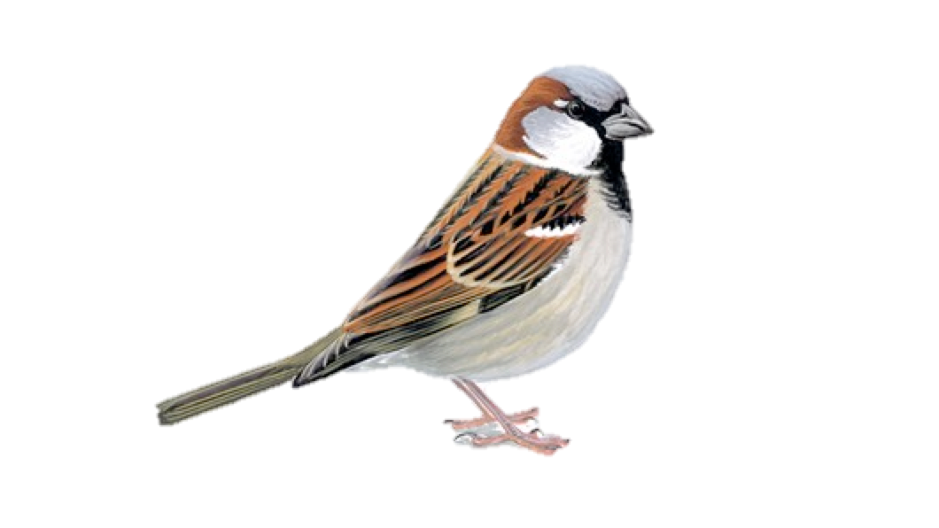
The method: Applications to sparrow conservation
Matthiopoulos, J., Field, C. & McLeod, R. (In review) Habitat models accurately predict population change in nature.

Slide 41
The method: Applications to sparrow conservation
Matthiopoulos, J., Field, C. & McLeod, R. (In review) Habitat models accurately predict population change in nature.

Slide 42
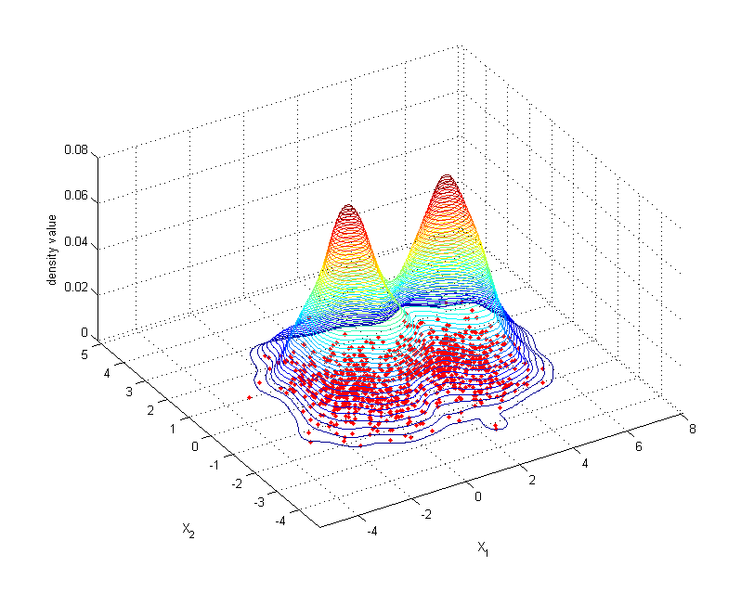
The method: Parametric approximation of habitat availability by a Gaussian mixture

Slide 43
The problem
Notes:
This problem revolves around the interplay between spatial and temporal autocorrelation discussed earlier. Consider one dimensional geographical (right) and environmental (left) spaces. Consider a particular type of habitat (encountered by following the contour line as it crosses the measurements of the habitat variable in G-space. This corresponds to a single point in E-space and the count of dots (in G-space), gives us the availability of this habitat (in E-space).

Slide 44
The problem
Notes:
Now, introduce mobility constraints. From any one of the original points, the organism may be constrained to within the little bell-shaped curves. The availability that it experiences must be somewhat different, but can we quantify it?

Slide 45
The problem
But, to deal with big data, can we do this analytically?
Notes:
Yes, by sampling around the locations of the dots according to the mobility constraints. This gives us a new histogram of availability. But if we want to be able to do this rapidly, for dealing with big data, we may need an analytical expression for availability. Can we obtain this?

Slide 46
The solution: Joint and conditional availability
The joint distribution of habitat availability for a given marginal habitat availability and three examples of the mobility constraint ( )

Slide 47
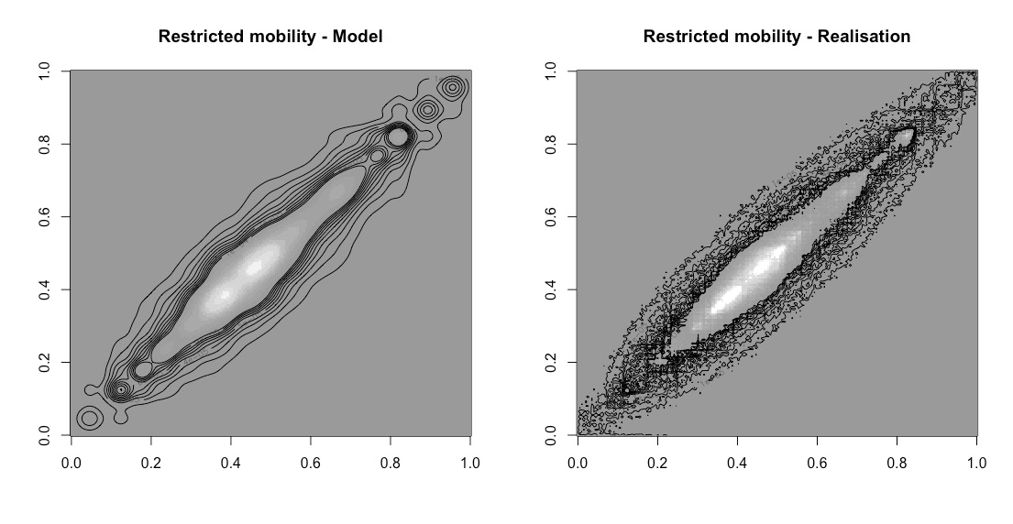
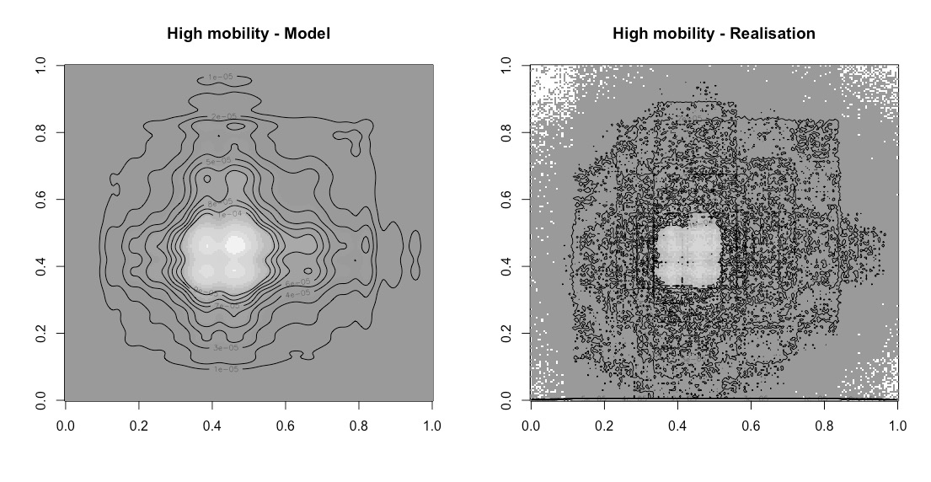
The solution: Joint and conditional availability
Matthiopoulos, J et al. (In prep) Within reach? Habitat availability as a function of individual mobility and spatial structuring

Slide 48
Implications of mobility for fitness
Mobility
Fragmentation

Slide 49
Conclusion

Slide 50
Overview
Individual movement
Large-scale distribution
Long-term
population dynamics
Moving from one level of complexity to the next, leaves behind some biological features. E.g. many different modes of movement will give us the same population distribution. Many different uses of habitat will give us the same population dynamics.
Species-habitat association models are the most expedient way of analyzing big data to answer large-scale and long-term questions. It may be possible to answer questions at all three levels under this single inferential framework.

Slide 51

An afterthought about slow movement
Issues of accessibility are grander and slower-moving in plant dispersal (more-generally, species range change).
These systems should not be considered off-limits for movement ecologists.
Hectare of tropical forest in Peru obtained using Carnegie Airborne Observatory (CAO) laser-guided imaging spectroscopy.
Image: Asner et. al, 2017

Slide 52
Thank you.
Email me for copies of this talk and information about R libraries and implementation
Jason.matthiopoulos@glasgow.ac.uk

